Slide 1
European Union Diabetes Clinical Trial
Effects of Liraglutide Medical Treatment on Cardiac Events in Diabetic Individuals
By Daniel Benson

Slide 2
About The Trial
Main Objective: analyze the effects of medical use of Liraglutide against placebo users of cardiovascular events
Time range: 3.5 - 5 years (the trial ran from 2010 – 2015, with final analysis occurring in 2016 and publication in 2017)
Participants: Adults with type 2 diabetes and higher risk of cardiovascular events
Trial allocation: Randomized and controlled
Double blind
Experimental group given liraglutide injections; control group given placebo injection

Slide 3
About The Drug
Liraglutide: Medicinal injection used in type 2 diabetics to help control blood sugar levels
Used in conjunction with diet and exercise plan
Also used to help reduce heart attack, stroke, and death in patients with type 2 diabetes and heart and blood vessel disease combination
Source: MedlinePlus. Liraglutide Injection. Pulled on 9/15/2022 from https://medlineplus.gov/druginfo/meds/a611003.html

Slide 4
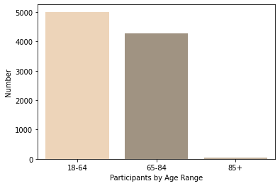
Demographics
Ages:
18-64 – 5011 Participants
65-84 – 4287 Participants
85+ – 42 Participants

Slide 5
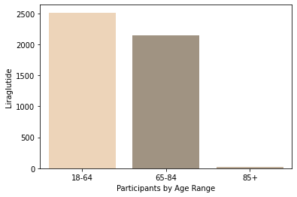
Demographics – Experimental Group
Ages:
18-64 – 2512 Liraglutide Participants
65-84 – 2139 Liraglutide Participants
85+ – 17 Liraglutide Participants

Slide 6

Demographics – Control Group
Ages:
18-64 – 2499 Placebo Participants
65-84 – 2148 Placebo Participants
85+ – 25 Placebo Participants

Slide 7
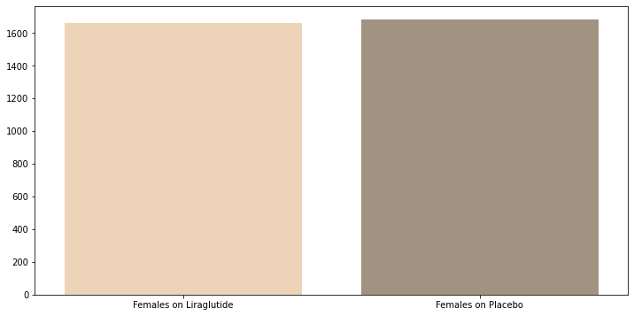
Demographics – Female Participants
Females:
On Liraglutide – 1657
On Placebo – 1680

Slide 8
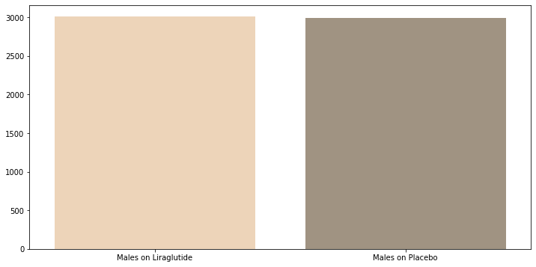
Demographics – Male Participants
Males:
On Liraglutide – 3011
On Placebo – 2992

Slide 9
Demographics - Countries Involved
European Union Countries:
Austria
Belgium
Czechia
Denmark
Finland
France
Germany
European Union Countries:
Greece
Ireland
Netherlands
Poland
Spain
Sweden
UK

Slide 10
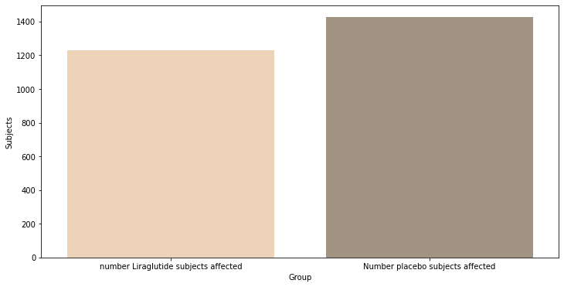
Results – Total Participants Affected with Cardiac Condition During Trial
Subjects Affected:
Liraglutide Participants: 1228
Placebo Participants: 1426

Slide 11
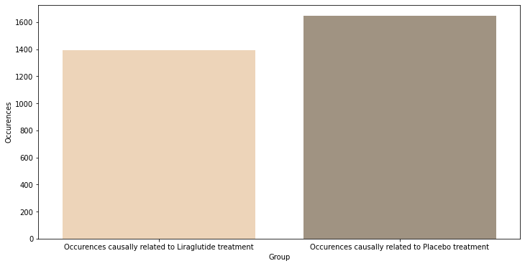
Results – Total Occurrences of Cardiac Event During Trial
Total Occurrences:
Liraglutide Occurrences: 1392
Placebo Occurrences: 1646
This means some subjects had more than one cardiac event occur during the span of the trial!

Slide 12
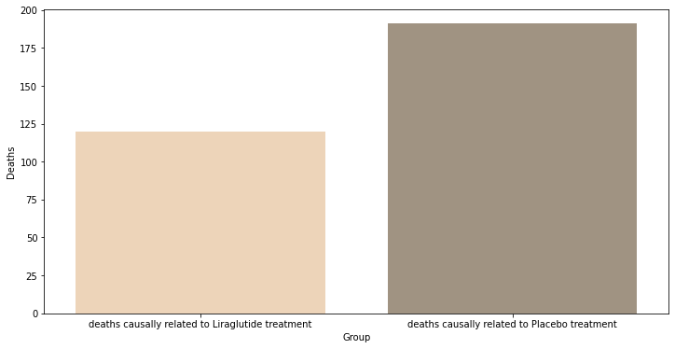
Results – Total Deaths Due to Cardiac Event During Trial
Total Deaths:
Liraglutide Deaths: 120
Placebo Deaths: 191

Slide 13
Conclusion
Data suggests that the use of Liraglutide in patients with Type 2 Diabetes and heart conditions decreases the likelihood of a cardiac event occurring.
Percent of death occurring after cardiac event in Liraglutide patients: 8.6207%
Percent of death occurring after cardiac event in Placebo patients: 11.6039%

Slide 14
Conclusion
Percent of cardiac event-related deaths occurring in Liraglutide subjects: 2.5707%
Percent of cardiac event-related deaths occurring in Placebo subjects: 4.0882%
Percent of cardiac event-related occurrences in Liraglutide subjects: 29.8201%
Percent of cardiac event-related occurrences in Placebo subjects: 35.2312%

Slide 15
Sources
Marso, Steven P. et. al. 2016. Liraglutide and Cardiovascular Outcomes in Type 2 Diabetes. N Engl J Med. 375 (4):311-22. doi: 10.1056/NEJMoa1603827.
MedlinePlus. (nd). Liraglutide Injection. Pulled on 9/15/2022 from https://medlineplus.gov/druginfo/meds/a611003.html

